Slide 1
XY Dependence in 3D Quad Measurement

Slide 2
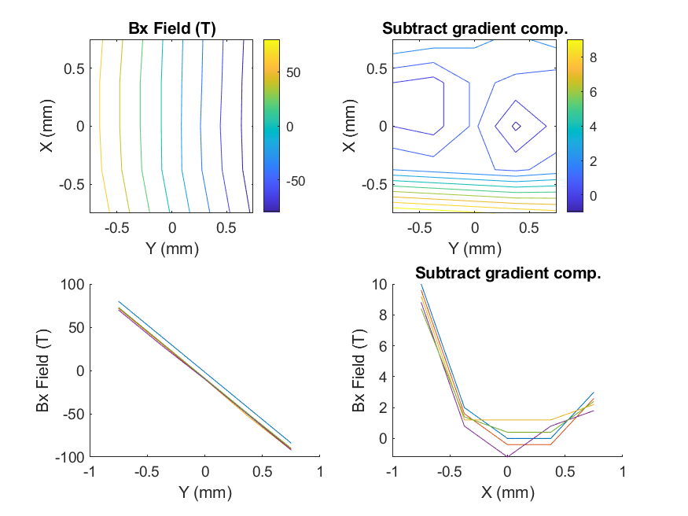
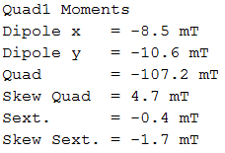
Quad1, Bx
text

Slide 3
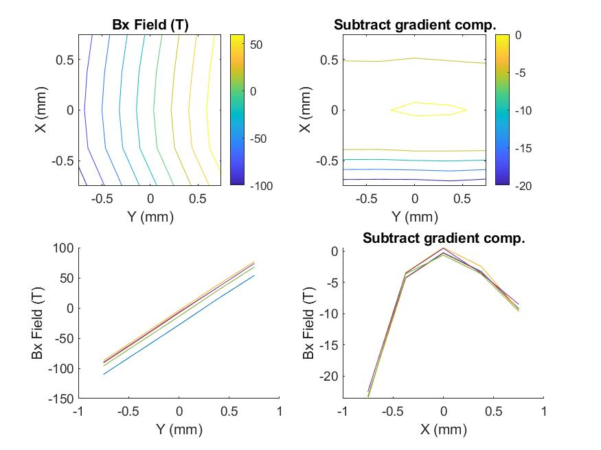
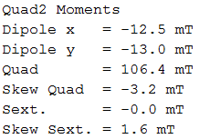
Quad2, Bx
Sign of sextupole moment flipped due to different quad focusing?

Slide 4
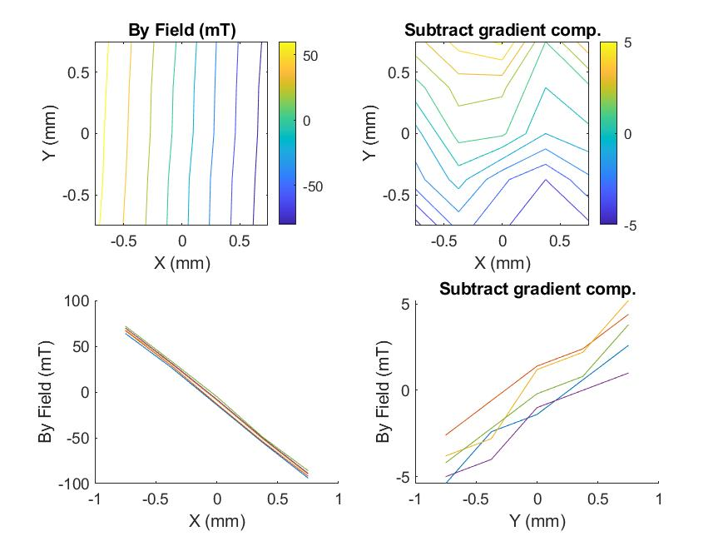
Quad1, By
By vs Y dependence from error in Probe roll angle?
This would imply same errors between Quad1 and Quad2

Slide 5
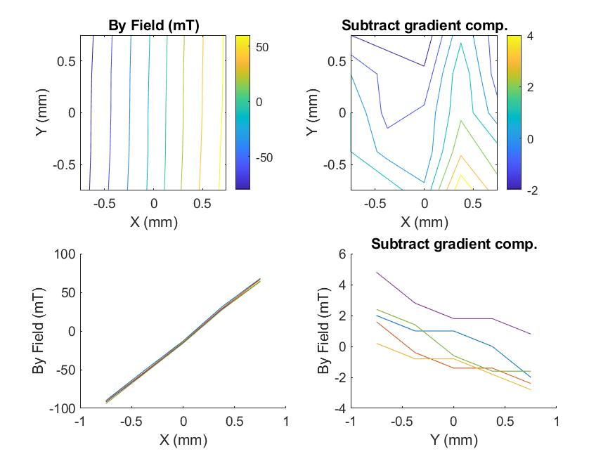
Quad2, By

